Slide 1

HR Data Analysis
for Employee Satisfaction and Retention
- By Chetna Shirke

Slide 2
Table of Content
Introduction
Objective
Data Description
EDA(Exploratory Data Analysis)
Data Visualization
Data Partition
Model Building
Conclusion

Slide 3
Introduction
The HR Data Analysis project aims to analyze and gain insights from a dataset containing various HR-related parameters.
The dataset includes information on employee satisfaction, last evaluation score, number of projects, average monthly working hours, time spent at the company, work accidents, employee turnover, promotions in the last 5 years, department, and salary level.
This project is to identify factors that influence employee satisfaction and retention, enabling the organization to make data-driven decisions to improve employee engagement and reduce turnover.

Slide 4
Objectives
1
To Predict will employee leave company or not.
2
Use this information to make informed decisions.

Slide 5
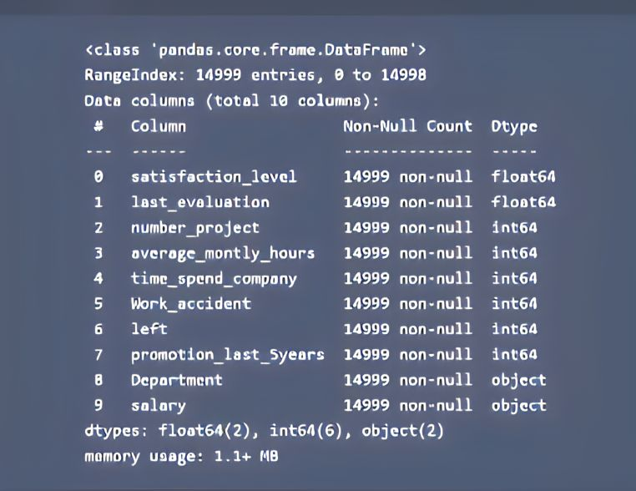
Data Description
Here we have 14999 rows and 9 columns in data.
In Data we have datatype of float, integer and object.

Slide 6
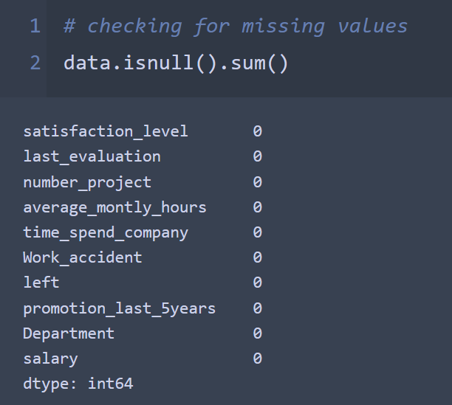
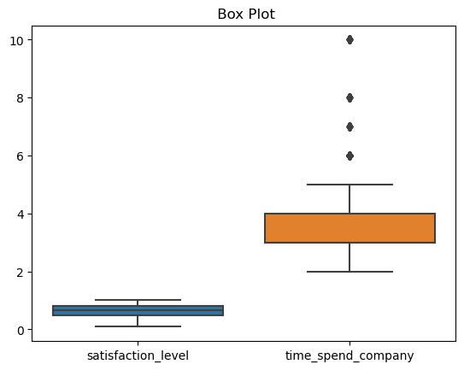
EDA(Expletory Data Analysis )
Here we checked for missing values, we do not have missing values in our data.
Here we checked for outliers, there are outlier in data and we do scaling to treat outliers.

Slide 7
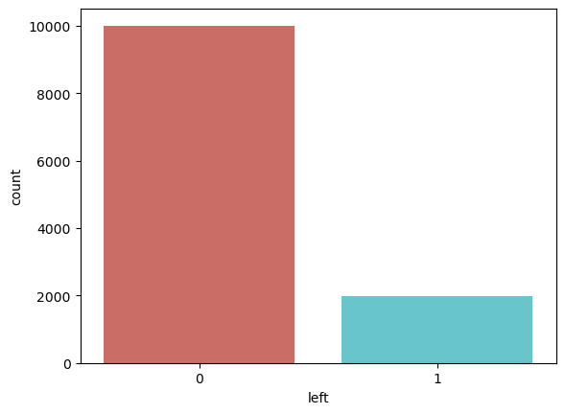
Data Visualization
This graph shows the count of Y variable i.e. will employee left the company or not.
0 is the code for employee won’t leave company and 1 is for employee will leave company.

Slide 8
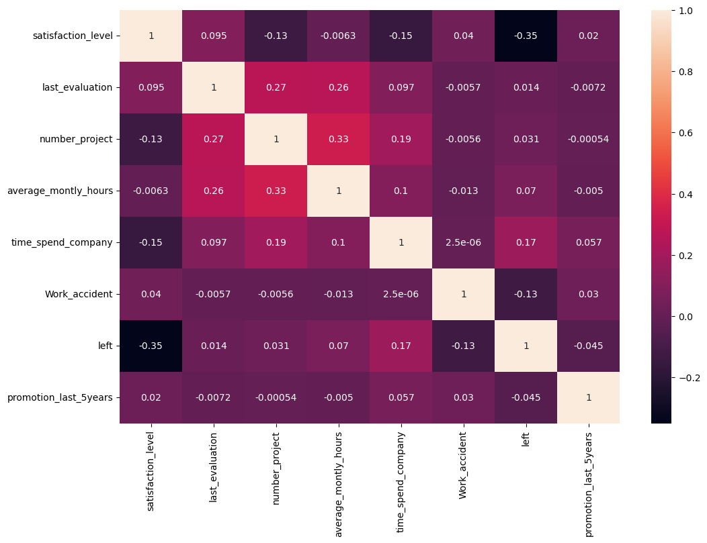
Data Visualization
This heatmap shows the strong positive correlation in between variable time_spend_in_company and last_evaluation.
Value for correlation is 0.097.
After this last_evaluation and satisfaction_level these two variable have strong positive correlation of 0.095.

Slide 9
Data Partition
We have split data into 70% and 30% part.
Train Dataset (70%)
Test Dataset (30%)
Dataset

Slide 10
Model Building
I have applied various model on data but best fit model is SVM because in logistic regression f1 score is low so we cannot say our model is best fit.
After hyper tuning I get SVM is Best Fit Model.
Sr. No. | Model | Train Accuracy | Test Accuracy
1 | Logistic Regression | 83.14% | 83.95%
2 | SVM | 98.26 % | 97.66%
3 | Random Forest | 99% | 100%

Slide 11
Conclusion
The best fit model our data is in Support Vector Machine Support vector Classifier.
From this best fit SVM model we get test accuracy is 97.66%
we can predict weather employee left the job or not is 97.66% accurate using above model.
From this project I got to know the real time implementation of tuning parameter of SVM algorithm.

Slide 12
Thank You !

